Slide 1
EnergySharp
BizEng Team
Yirui Tao, Binh Mai, Inho Kim, Joy Lai

Slide 2


Buildings are bountiful and bad for the environment.
Introduction
Currently, the construction and buildings industry is responsible for 40% of global energy-related emissions. This is the highest among all emission-releasing sectors.
Heating, ventilation, and air conditioning (HVAC) systems are responsible for 40% of office building operation energy consumption.
Current systems are highly inefficient:
30% of energy consumption is wasted
Climate Change Implications
Corporation Operations Implications
Emissions contribute to the urban heat island effect, where temperatures in downtown cores can average up to 12C higher than surrounding areas
Exacerbated climate change and inequality, heat-related illnesses, extreme weather
Rising energy costs make building operation and management burdensome
The shift away from remote work make building resource efficiency crucial for employee productivity, retention, and engagement
Notes:
Taking a look around, the landscape is covered with buildings. Currently, this industry is responsible for 40% of global energy-related emissions. Inefficient heating, ventilation, and air conditioning (or HVAC) systems wastes 30% of that energy consumption.
This accelerates climate change and related consequences; on the corporate operations side, rising energy costs are burdensome and the shift to in-person work means an optimized pace is crucial for office attraction.

Slide 3



The building industry currently faces unique challenges that lead to specific opportunities.
Executive Summary
Challenges
Opportunities
80% of the buildings that will exist in 2050 have already been built. Only 20% would have to be optimized to reach climate targets.
Prioritize optimizing resource-use existing building stock (often overlooked)
All offices are different: no one-size fits all solution.
Consider real and internal data sources to best use resources specific to each building via automated workflows.
Office vacancies have increased to an all-time high (20% in Toronto in 2023).
Facilitate compliance with regulation and promoting ESG makes offices more attractive for leasing.
To reach key climate targets and achieve cost benefits, democratizing energy optimization in existing office building stock is a must. Inertia stems from a lack of know-how, not lack of initiative.
Notes:
Key challenges unique to the building industry
Since 80% of buildings that will exist in the next decades have already been built, we need to prioritize optimizing existing building stock
All offices are different, so data-based solutions would be needed since one solution does not fit all
Office vacancies are increasing to all time highs; offices are incentivized to optimize their HVAC to adhere to regulation and promote ESG to make themselves the most attractive options
Inertia stems from a lack of know-how, not lack of initiative. We need to democratize energy optimization in existing office building stock

Slide 4
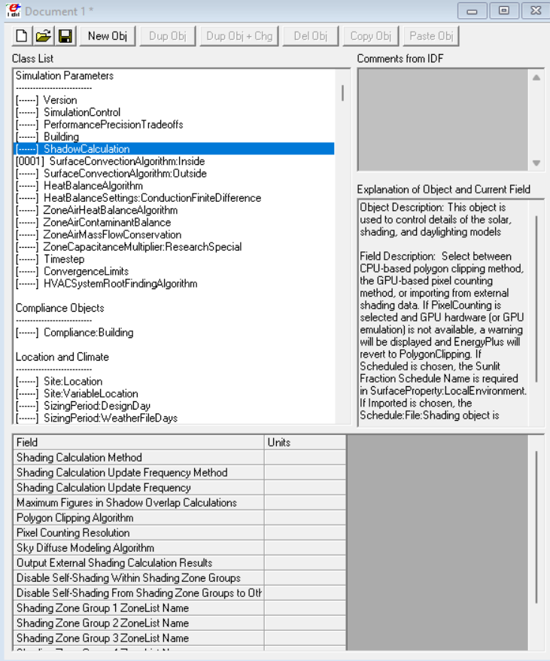

Current industry workflows are not optimized.
Current Industry Options
EnergyPlus (EP) – enabling Energy Optimization with data
Data Inputs
Data Outputs
Outcomes
Building Dimensions
Appliance info
Building and equipment (HVACs, etc) energy usage
Zone heating energy data
Track energy usage
Simulate new designs
Retrofit testing
However, EnergyPlus is difficult to use.
Need to understand building blueprints to create Inputs
Need to understand Outputs to create insightful Outcomes
Hard to interpret results, limited talent to consult
Time-consuming; unintuitive
Notes:
EnergyPlus is a gold-standard open source software whose value proposition is that it enables Energy Optimization with data
We did some market research, but there are no user-friendly alternatives that are an end-to-end process that can effectively replace EnergyPlus.

Slide 5






Task required: Hire external consultants who use EP.
Current industry workflows are not optimized.
Current Industry Options
1. Learn the software themselves
Task: Study graduate-level material
Time: High—months to years
Capital: Low to Medium
Building Owners/Managers
2. Hire a consultant
Our customer currently only have two choices to receive actionable data-based insights to optimize their buildings.
Both are costly, cumbersome, and capital-intensive.
Task: Hire an expert consultant who can use EnergyPlus.
Time: Medium—months
Capital: High—commercial energy audits can cost up to $15,000+ per project (EMS Environmental)
Notes:
This is an unsaturated market.
However, as you can expect, Energy Plus takes multiple graduate-level courses to begin to understand how to use this software to its fullest extent. The interface is complicated to use – it does not have any visual interfaces nor an easy-to-follow tutorials anywhere online. All we could find were graduate course lectures that were over 3h long for an “introduction” class.

Slide 6

ENERGY SHARP has the potential to disrupt, reinvent, and reinvigorate the industry.
Solution
EnergySharp
Planning your building’s optimized energy usage, one scan at a time.

Slide 7
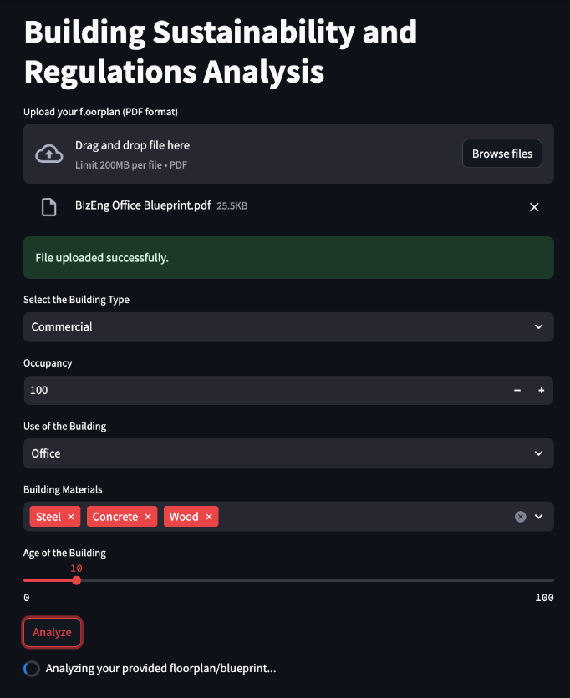
EnergySharp has the potential to reinvent the industry.
Enabling Mass Adoption Through an Intuitive Interface
Notes:
So as a visual representation, this is what the EP input screen looks like, the current gold standard software for building energy modelling and management. If you are the average manager, you see this software, and feel a massive barrier to taking the steps to sustainable actions. As mentioned before, it would take extensive time, work, or capital to leverage this software, even if the end outcomes can result in data-based sustainable outcomes.
Our purpose is to remove this barrier, to go from this (photo of EP) to this, an easy-to-use interface that is built on top of the EP legacy software. As you can see, it is significantly easier to input the data without having to follow a complicated tutorial or understand civil engineering.

Slide 8


EnergySharp has the potential to reinvent the industry.
Enabling Mass Adoption Through an Intuitive Interface
Image from: https://devblogs.microsoft.com/commandline/windows-command-line-backgrounder/ (Right)
Image from: https://en.wikipedia.org/wiki/Windows_7 (Left)
Notes:
This is similar to how the early stages of computers worked going from an inaccessible Command-Line Interfaces or CLIs(left) to a Windows system interface that allowed the mainstream user to participate in the ecosystem. CLIs work, but Windows is better.
And similarly, our business will enable accessible sustainable insights with mass adoption.

Slide 9



Our proposition simplifies the entire process.
Proposed Workflow.
Use the interface application.
Task required: Input building blueprint into a user interface. Receive actionable output.
Time required: Low
Building Owners/Managers
Capital required: Low
Our solution interface will enable users to directly leverage the EP system to gain actionable insights themselves.
We reduce the barriers of time and capital, facilitating the adoption of more sustainable practices.
Ease of use
Automated
Tailored
Low cost, high impact
Notes:
Ease of use – no formal education reqruied
Tailored – to each building’s specific needs and actionable outcomes.
Automated – workflow gives rapid and real-time results

Slide 10


Backend Code
EnergySharp’s workflow is clean, clear, and functional—streamlining the EnergyPlus system.
Workflow Overview
1. Upload Data
User uploads a 2D blueprint + other manual input data to the interface.
5. View Insights
User sees custom recommendations on the interface.
USER
BACKEND
CODE
2. Scraping
Computer vision scrapes the necessary input data from the uploaded blueprint and combines into idf file.
3. Input
Code uses EP APIs to input the scraped data + manual input data into EP and run it.
4. Output
Code converts EP outputs (.eso file) into meaningful insights and displays them on the interface.
Key Takeaway
Our solution removes the technical barriers that end users have in analyzing their infrastructure energy consumption behaviors.
Notes:
So what happens in the background for all of this to take place?
Let’s walk through the technical solution workflow that happens behind the scenes for our application.
First, users will be asked to upload a 2D blueprint of their space and manually input other required data
A computer vision model will scrape building dimensions and information from the 2D blueprint and combine it with the manually inputted user data in an EnergyPlus input file, also called an IDF file
Through EnergyPLus’s Python API, we will be able to insert our input file and run various simulations, including HVAC System Simulation and receive an output file
The output file is filled with technical terms and numbers – so we will convert them into actually interpretable and useful insights and suggestions for the user
Now, we’ll briefly go over what we have technically implemented in each stage of the process.

Slide 11
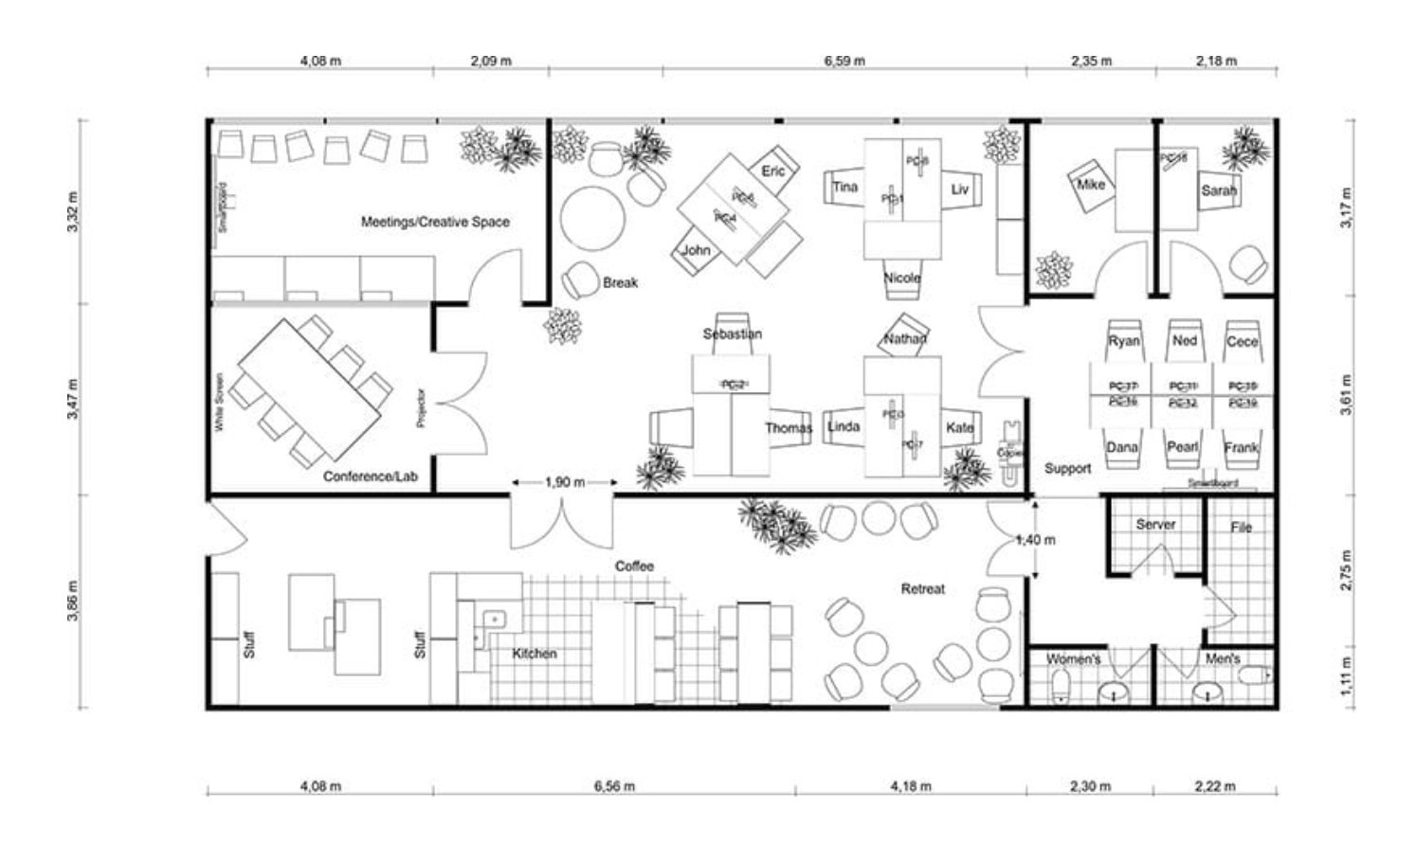
Workflow Overview – Step 1
Uploading data on the interface
1. User – Upload Data
Manual input of building information and usage (dotted)
2D Floor Plan or Blueprint upload
Notes:
For the first steps – users can upload their 2D floorplans to our user interface as well as other required information about the building, such as building materials and occupancy

Slide 12
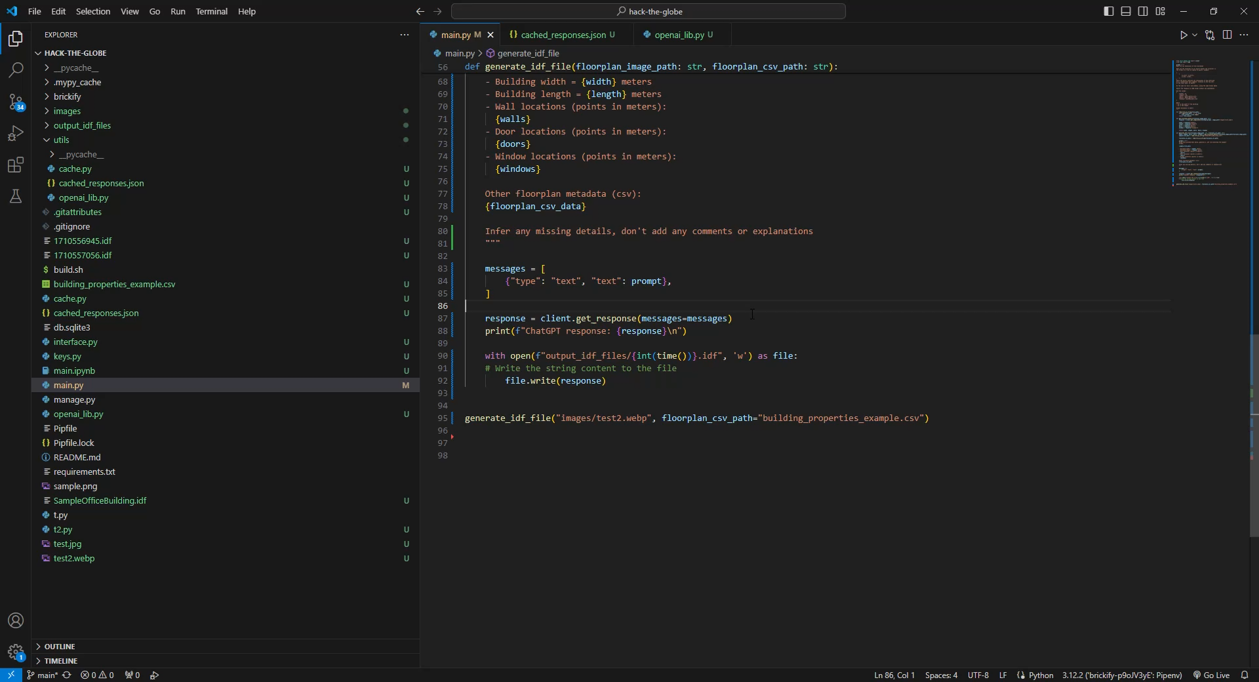

Workflow Overview – Step 2
Scraping input data from the building blueprints
2. Backend – Scraping
Recorded demonstration of running the OpenAI API and receiving the output
Blueprint input from interface
OpenAI API with GPT4
on Python with Few Shot Prompting
Output:
IDF formatted text file suitable for EnergyPlus Simulation
Notes:
All of this user-inputted information is sent to GPT4
Which scrapes building dimensions, HVAC locations, and window placements from the floorplan using few-shot prompting
Then combines everything into EnergyPlus’s format specific input file – an idf file

Slide 13
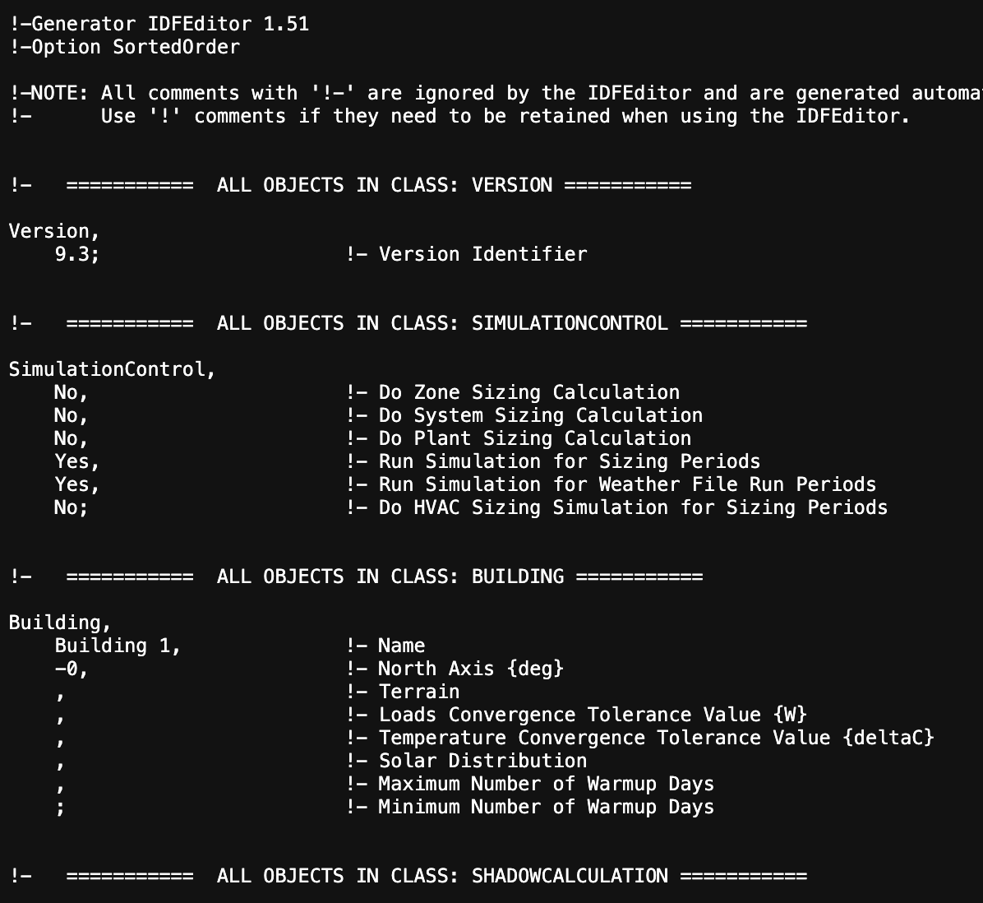
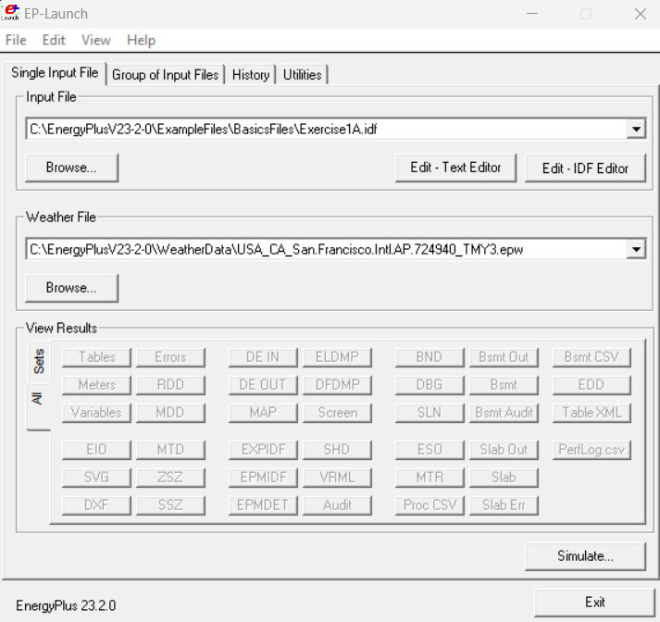
Workflow Overview – Step 3
Converting user input into EnergyPlus input files
3. Backend – Input
Created Sample IDF File
Input into EnergyPlus Simulation via APIs
Notes:
The generated idf file is inputted into EnergyPlus through an it’s python API and a simulation is run

Slide 14
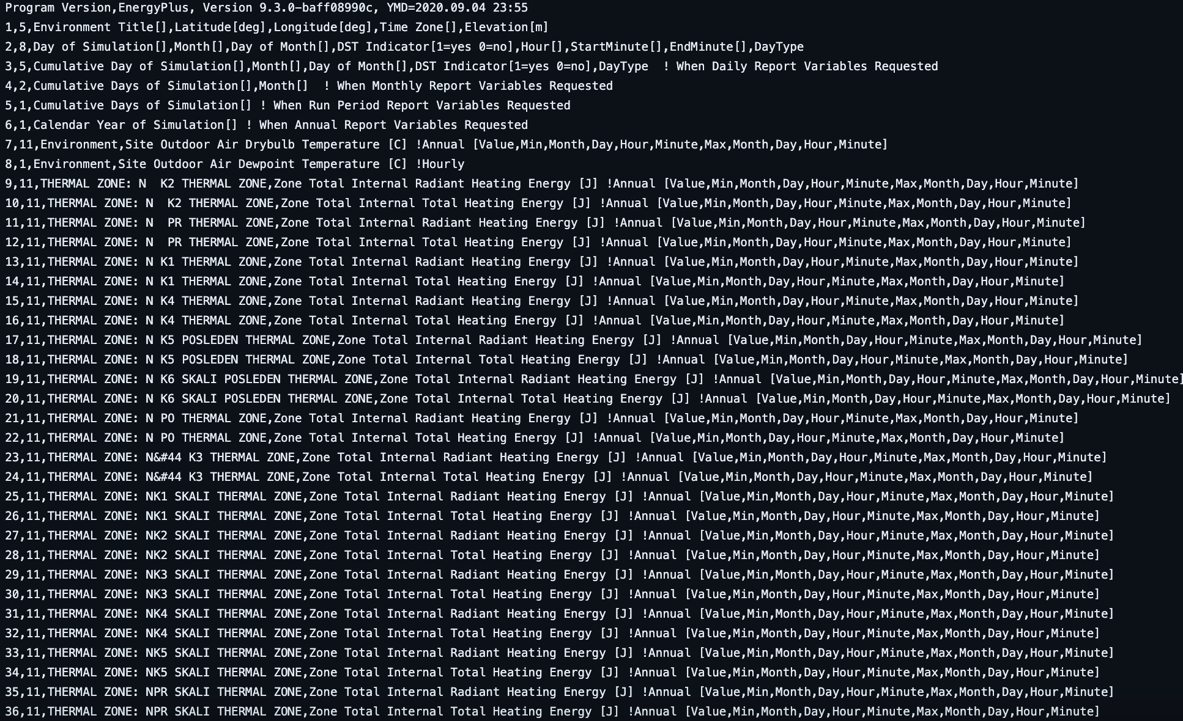
Workflow Overview – Step 3
Running EnergyPlus Simulations
3. Backend – Input
EnergyPlus Simulation
Complex EnergyPlus Output File
Notes:
The simulation outputs a complex output file filled with technical terms and numbers

Slide 15
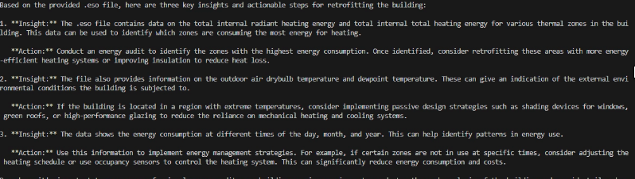
Workflow Overview – Step 4
Creating actionable outcomes from EnergyPlus outputs
4. Backend - Output
Complex EnergyPlus Output File
OpenAI API
on Python with Zero Shot Prompting
GPT4 Output in Terminal: Key Insights for User
Notes:
Which are then converted into interpretable and meaningful insights for the user

Slide 16
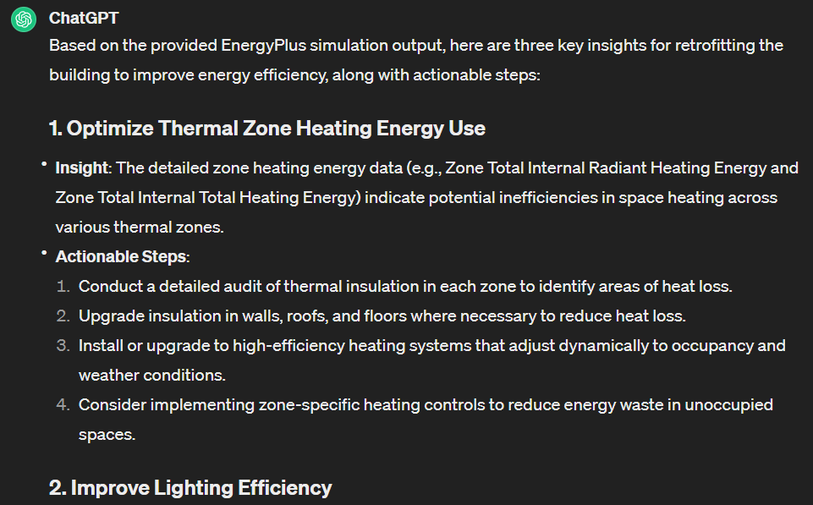
Workflow Overview – Step 5
Displaying insights and actionable steps on an interface
5. User – View Insights
The User can view summarized customized insights and actionable steps on the interface.
Below is a sample output we can get from OpenAI APIs with reading EP data:
Feasible
Data-based
Specific
Holistic
Actionable
Notes:
There are different areas that the AI targets such as heating or lighting. It gives the user a data-based insight, and follows up with actionable steps they can take to improve their building sustainability.

Slide 17


We target the right people, at the right time.
Customer Analysis
Before EnergySharp
After EnergySharp
Often excluded/does not understand the energy optimization process
Confused and thus unwilling to improve energy efficiency
Given incentive as the ultimate decision-maker to optimize energy efficiency
Given actionable steps to take to easily enhance their building operations practices
Building Managers
Often overlooked when discussing improving sustainability in the building industry
In a policy “blind spot” where new regulations do not apply
Targeted, easily implementable solutions that are not cumbersome (eg. demolishing)
Potential to create the most change in impact and magnitude due to the large amount of existing buildings
Existing Building Stock
Notes:
Building managers are key decision makers in building operations, but they are often excluded from the conversation, are confused, and thus unwilling to take action. Energy sharp gives clear, actionable steps they can follow.
Existing building stock is often overlooked since existing policies don’t apply. Targeting this area creates the most change in impact and magnitude.

Slide 18
EnergySharp will operate with a self-supportive financing model.
Business Model
Features Bundles Pricing
(2027-)
Subscription Pricing
(2025-)
Continued developing software based on customers feedback, testing, introducing new features that customized customer experiences
Project-based Pricing
(2025-)
Continue usage of software with access to impact measurements (e.g., cost savings, Carbon emissions reductions, KPIs, etc.)
Tiered-pricing models based on office size
Partner with building managers to develop customized software
Provide action plans for managers
Sources of funding: Venture Capitalist, Government Grants, Partnerships with sustainability-focused groups (long-term)
Notes:
3 main revenue streams:
project-based pricing – meet with building managers to discuss the needs -> integrate these requests into our engine for customized software -> provide action plans
Subscription pricing – continue to use the software, provide impacts of changes implemented (cost savings, KPIs, etc.)
Feature bundle pricing (for the growth stage) – as we continue to develop & collect feedback -> introduce new features that customers can add features
Financing sources: venture capital, government grants , long-term partnerships with sustainability-focused

Slide 19

EnergySharp will be created and implemented over a 5-year period.
Business Model
Timeline
5-year Costs & Revenue Projections
2025 - 2026
R&D (6 months)
Conduct market research, Develop AI model for HVAC optimization & interface
Beta Testing (6 months)
Small group pilot testing, Gather feedback & iterate on product based on user experience
2026 - 2027
Adoption Stage (6 months)
Detail 1
Launch full version of EnergySharp, Implement marketing & sales strategies to attract new customers
Scaling (18 months)
Increase customer base while improving the product based on user feedback Expand marketing efforts to reach wider audience
2027 - 2029
Growth Phase (12 months)
Introducing new features bundle, upselling
Optimization (18 months)
More customizable features and impact measurement metrics
Notes:
1st stage:
Understand competitive landscape in the HVAC system, large investments
Beta testing – offer discounts to small groups to incentivize
2nd stage:
Adoption: launch full

Slide 20



EnergySharp is scalable - Expansion Strategies
Business Model
Vertical expansion to different types of sustainable action plans (eg. retrofit, energy reduction, airflow optimization) based on specific customer feedback and inputs.
Potential Horizontal expansion to automate more legacy systems through leveraging AI.
Increase Use Cases
Expert Consultations
Consultation with experts to constantly improve software development.
Develop custom AI models to interpret more other diagrams (mechanical, structural, HVAC).
Aggregate user data and feedback to refine app workflows.
User Expansion
Target, scope, and expand user base through streamlined marketing and customer engagement workflows.
Increase mass adoption of sustainable data-based practices.
Notes:
Develop AI models so we can get better recommendations.

Slide 21
EnergySharp optimizes building energy use such that all stakeholders are satisfied
Impact Summary
EnergySharp offers a tailored, scalable, and intuitive system that disrupts existing inertia in addressing a “hard-to-reach” and historically neglected emissions sector. All impacts will only expand as ENERGYSHARP reaches its full potential.
Addressing Climate Change
Addressing Building Management/Owner Challenges
40+% REDUCTION in carbon emissions (Brainbox AI)
Up to $15,000+ SAVED in consulting costs per project
50+% INCREASE in energy efficiency (Brainbox AI)
20-40+% REDUCTION in energy usage and costs (Chiller&Cooling Best Practices)
3000+ BUILDINGS OPTIMIZED over the next 5 years with sustainable HVAC (Projected Numbers)
10+% BOOST in worker productivity and attendance records due to ideal temperatures, air quality, and comfort (Alford Mechanical).
45+% DECREASE in future energy demand (IEA)
Save MONTHS worth of time: ENERGYSHARP does in seconds what consultants do in months.
Notes:
Also: decrease HFC production associated with excessive HVAC and AC usage (since it’s a fuel source)

Slide 22
Appendix

Slide 23
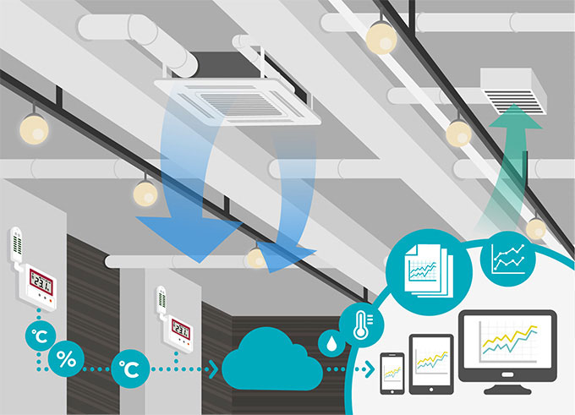
Buildings are bountiful and bad for the environment.
Introduction
Currently, the construction and buildings industry is responsible for
Heating, ventilation, and air conditioning (HVAC) systems are responsible for 40% of office building energy consumption
Current systems are highly inefficient: 30% of energy consumption is wasted
40%
of global energy-related emissions (the highest among all sectors)
30% is from operation energy consumption.
Emissions contribute to the urban heat island effect, where temperatures in downtown cores can average up to 12C higher than surrounding areas
Increased pollution and air temperatures create a positive feedback loop that intensify UHIs
Exacerbated climate change and inequality, heat-related illnesses, extreme weather

Slide 24

Major cities around the world are home to large stocks of inefficient office buildings.
Introduction
Most buildings that have the most egregious energy performance already exist—and they are offices.
80% of the buildings that will exist in 2050 have already been built
Existing building stock needs to be a priority in creating strategies toward sustainability. This area is currently often overlooked.
In urban areas, buildings account for 60% of overall carbon emissions.
Building energy use inefficiencies must be identified and eliminated to optimize resource use. This area is currently lagging in reaching Paris Agreement outlines.
Established models for improving existing building stock centers on demolishing and rebuilding. This is costly, inefficient, and hard to justify.
Buildings must focus on compiling and processing data to optimize performance using their existing resources. These opportunities are often nebulous and hard to envision.
To reach key climate targets and achieve cost benefits, energy optimization in existing office building stock is a must.

Slide 25






Major cities around the world are home to large stocks of inefficient office buildings.
Introduction
There is an increasing interest in enhancing building energy performance.
Multiple stakeholders would benefit from building energy efficiency.
Rapidly rising energy prices make office spaces costly and burdensome for corporations and managers.
Office workers benefit from increased productivity due to optimized HVAC.
Vacancy rates in offices are soaring: Toronto’s reached a high of 20% in 2023. Especially with the transition away from remote work, offices want to lower costs and become more attractive.
Building managers will save costs and meet regulation/ESG goals.
Increased government regulation means that corporate emphasis on CSR and ESG make a sustainable building the most attractive option.
Real estate companies reduce vacancy by making their buildings more attractive.

Slide 26
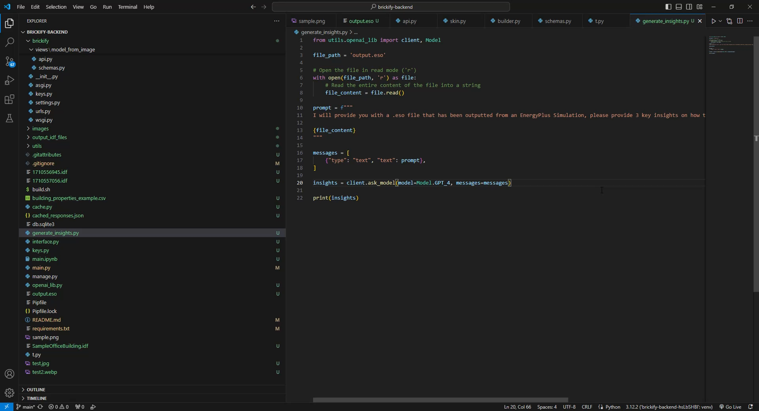
Workflow Overview – Step 5: Video Demonstration
Displaying insights and actionable steps on an interface
5. User – View Insights
USER INPUT
(office building floor plan, basic parameters including building materials, occupancy, etc.
OpenAI API
on Python with Few Shot Prompting
Output:
IDF formatted text file suitable for EnergyPlus Simulation

Slide 27
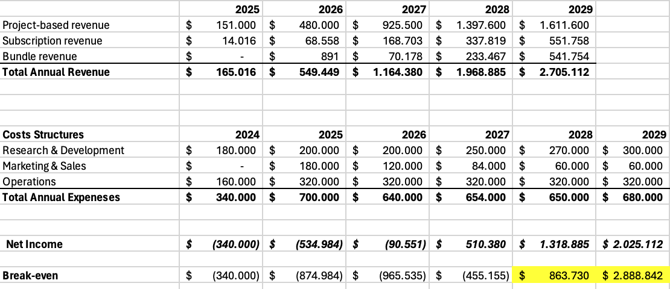
Costs & Revenues Schedules 2024 - 2029
Excel included in GitHub

